Slide 1

Data Analysis on Spotify
~by Mitali sawant

Slide 2
Problem Statement :-
To analyze individual Spotify streaming history data to uncover listening patterns, user behavior, content preferences, and engagement trends, with the goal of understanding music consumption habits and identifying patterns in loyalty and interaction.

Slide 3
🎯 Project Objectives
🔹 Listening Behavior Insights
Analyze top artists and songs based on total listening time.
Compare artist preferences between current and previous years.
🔹 Time-Based Listening Trends
Identify peak listening hours and most active days of the week.
Track monthly and yearly shifts in engagement.

Slide 4
🎯 Project Objectives
🔹 Engagement & Skip Behavior
Evaluate the most frequently skipped songs and artists.
Analyze skip behavior on top/favorite tracks (skip rate).
🔹 Discovery vs. Loyalty Patterns
Detect how often new artists are discovered and when .
Track monthly and yearly shifts in engagement.
Classify artists as “new this year” vs. “familiar from before”.

Slide 5
Dataset Overview - Spotify Listening History
Feature | Description
track_name | Title of the track played
artist_name | Artist who performed the track
album_name | Album the track belongs to
date, time | Date and time of the playback
sec_played | Duration of listening (in seconds)
skipped, shuffle, reason_start, reason_end | Playback behavior flags
platform | Device/platform used for streaming

Slide 6
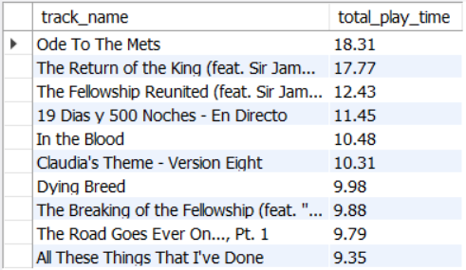
SQL Queries :-
Que 1. Top 10 most played tracks by total play time
Output →

Slide 7
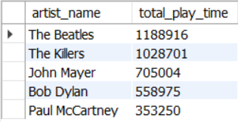
Que 2. Which artists have the most play time overall
Output →

Slide 8
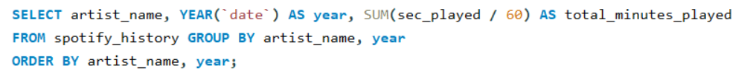
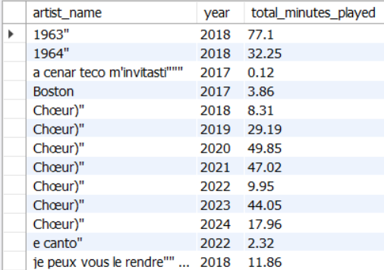
Que 3. Artist comparison by year
Output →

Slide 9
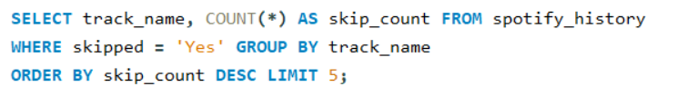
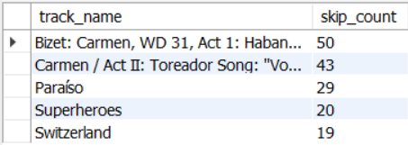
Que 4. Most skipped songs
Output →

Slide 10
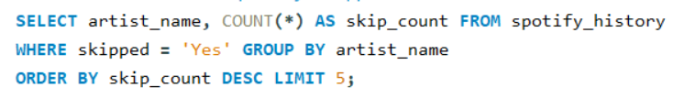
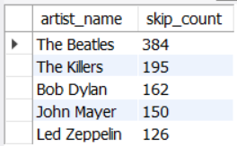
Que 5. Artists most frequently skipped
Output →

Slide 11
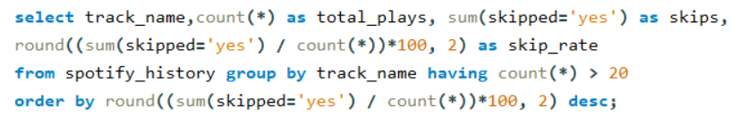
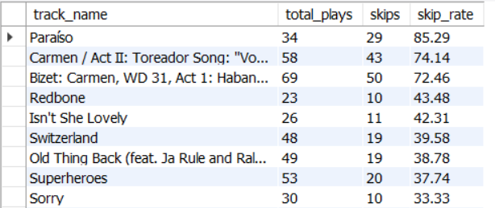
Que 6. skipped rate of popular songs
Output →

Slide 12
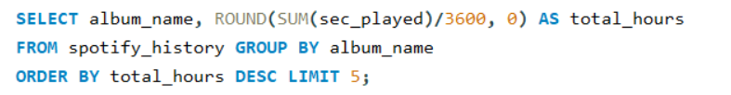
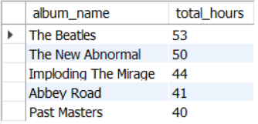
Que 7. Most listened albums
Output →

Slide 13


Que 8. Count of suffles and manual plays
Output →

Slide 14

Que 9. How often autoplay was used
Output →

Slide 15
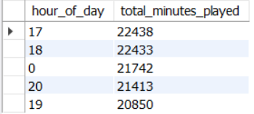
Que 10. Time of day when music is most played
Output →

Slide 16

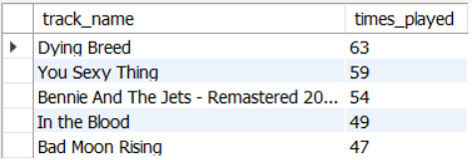
Que 11. Top 5 songs played on weekends
Output →

Slide 17

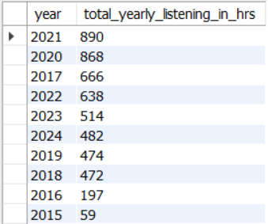
Que 12. Top songs played yearly
Output →

Slide 18
Days with the highest play counts 2017-09-06 1391
2022-09-30 825
plays overtime
2013-07-08 42
2013-07-09 20
Average play time per artist
Cory Weeds 662
Dan Lacksman 645
count of Playback end reasons
trackdone 76161
fwdbtn 50553
first appearance of artist
The Mowgli's 2013-07-08
Calvin Harris 2013-07-08
Insights and Actions :
Average play duration per track
Tubular Bells - Pt. I 26
Tubular Bells - Pt. II 23
how many unique songs were played
13468
Which platform was used the most
android 135610
Total daily listening
2020-12-20 13.43
Total monthly listening in hrs
October 554.28

Slide 19
📊 Conclusion
We identified top artists, songs, and albums with the highest play time.
Time-based patterns revealed peak listening hours and weekend engagement.
Skipping behavior highlighted which songs were often skipped — even among favorites.
The comparison between years showed changes in artist preferences.
We also explored how often new artists were discovered.

Slide 20
THANK YOU

